Slide 1
Exploring Brave New Worlds: Some Thoughts on Alternative Protein Sources
John B. Cole, PhD
PEAK Sr. VP for Research & Development
john.cole@urus.org

Slide 2
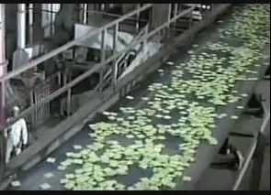
What are we really talking about?
Replacement of food with highly engineered products
  Cultured meat
  Insect protein
  Plant-based materials
Demand is driven by the creators of these products
Environmental concerns are used as a justification

Slide 3
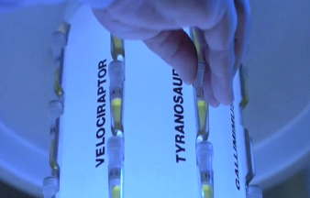
New technologies
Gene editing methods are complementary to well-understood animal breeding techniques.
Replacing meat from livestock with cultured material is not only unproven at scale, it may be impossible!
Turning insects into protein powder is straightforward.

Slide 4
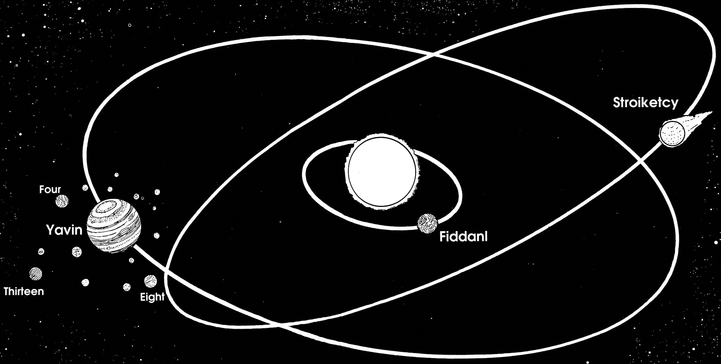
Systems matter
Livestock systems have lots of room for improvement
  Genetics
  Dietary amendments
  Waste management
Technologies can be added into systems
  They’re not useful per se
People are part of systems
  Very little is as central to cultures as food

Slide 5

Who ends up in control?
Farmers have control over their livestock, for now…
Some people believe products of natural breeding should be intellectual property!
Others believe the animals that sustain families and communities should be replaced with chemical plants.
Should we really trust those who believe everything can – and should – be owned to have our collective interest at heart?

Slide 6

Ad Astra
We’re never going to reach the stars if we’re solving the wrong problems.
We know how to feed people – we can’t stop doing that!
We need to know more about reducing the environmental burden of agriculture – why don’t we focus on that instead?

